Slide 1
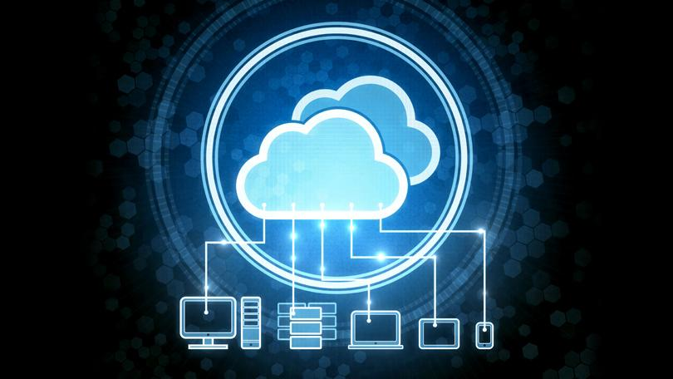

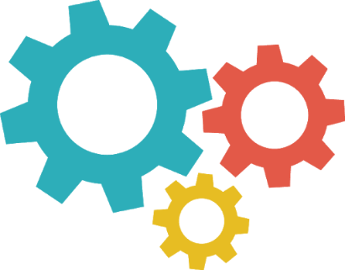
Cloud Computing Fundamentals

Slide 2
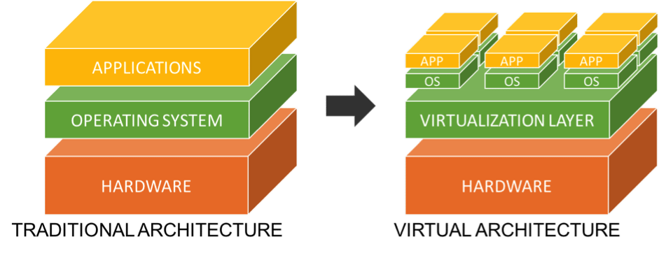
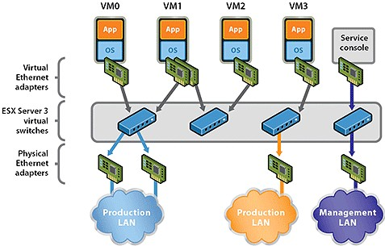
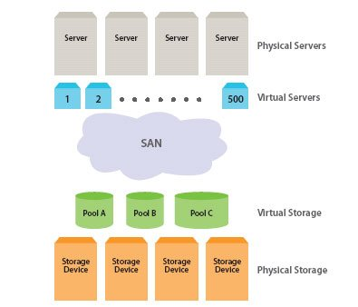
Virtualization
Quality of effecting something without being the actual-thing
In computing, virtualization refers to the act of creating a virtual version of something, including virtual computer hardware platforms, storage devices, and computer network resources
?
MVP Phase
Network virtualization is the process of combining hardware and software network resources and network functionality into a single, software-based administrative entity, a virtual network.
Phase II & III
and
Support
Phase
Storage virtualization is the pooling of physical storage from multiple storage devices into what appears to be a single storage device -- or pool of available storage capacity -- that is managed from a central console.

Slide 3
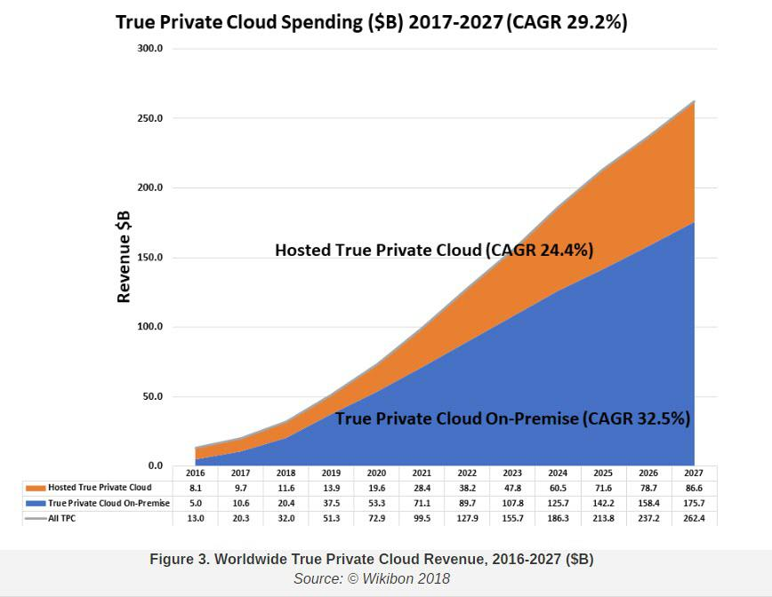
Virtualization Market
The global market for Server Virtualization Software is expected to witness a 13.3% spurt in revenues for the year 2020 and thereafter reach US$11.1 billion by the year 2027, trailing a post COVID-19 CAGR of 6.7% over the analysis period 2020 through 2027 – Source: Report Linker
?
MVP Phase
Phase II & III
and
Support
Phase

Slide 4
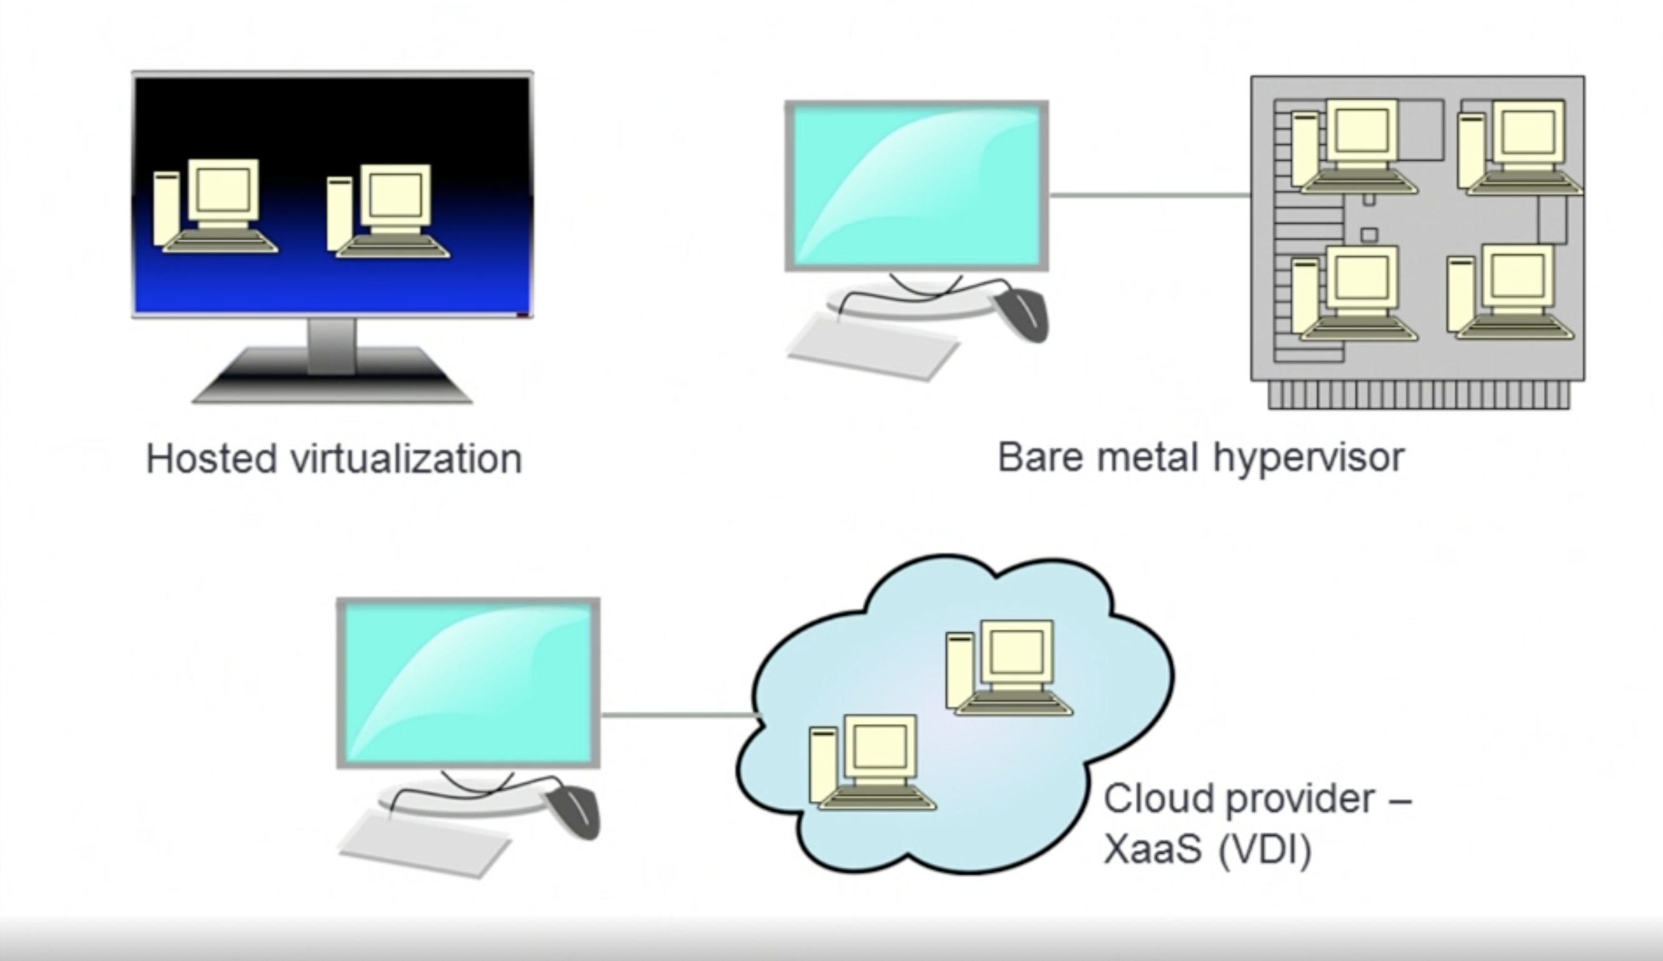
Different VM Models
Type-2 Hypervisor
Type-1 Hypervisor
?
MVP Phase
Phase II & III
and
Support
Phase
Desktop Virtualization

Slide 5
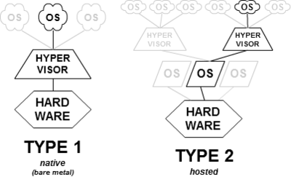
Type -1 Vs Type-2 Hypervisors
?
MVP Phase
Phase II & III
and
Support
Phase

Slide 6
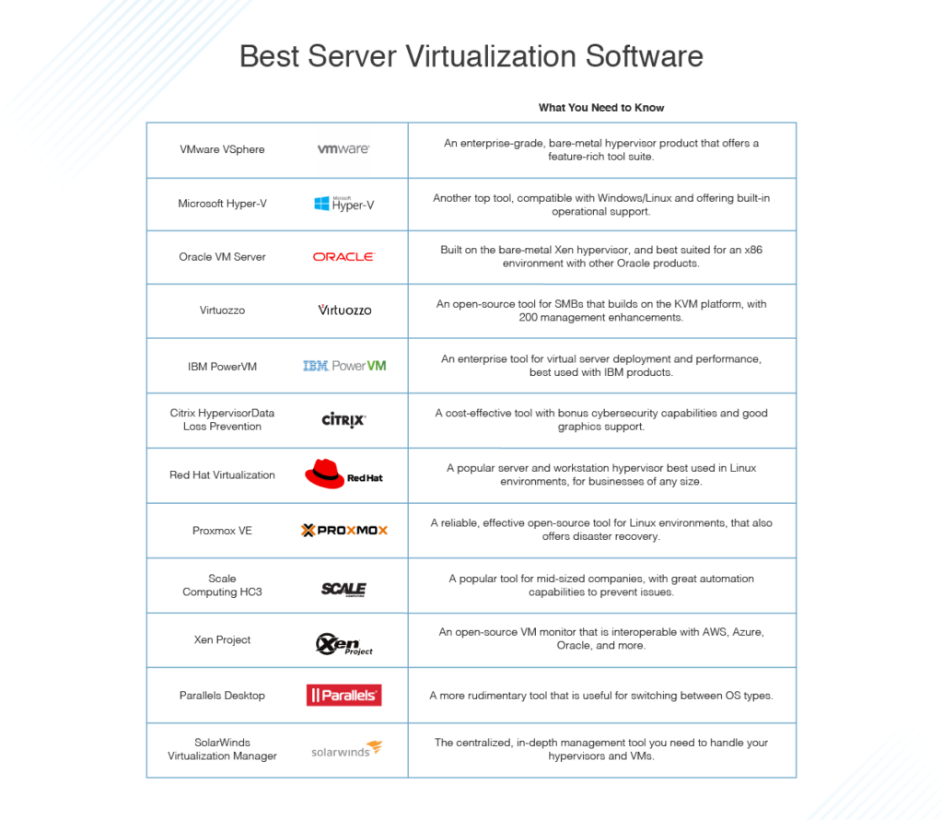
Type -1 Hypervisors
?
MVP Phase
Phase II & III
and
Support
Phase
Notes:
VMware ESXi (formerly ESX) is an enterprise-class, type-1 hypervisor developed by VMware for deploying and serving virtual computers

Slide 7
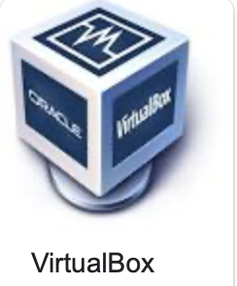
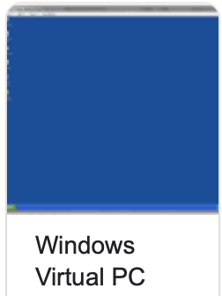
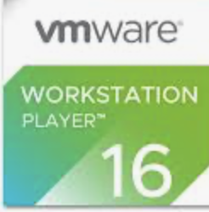
Type -2 Hypervisors
?
MVP Phase
Phase II & III
and
Support
Phase
Runs on top of Host OS
Typically used for Development and Testing
Notes:
VMware ESXi (formerly ESX) is an enterprise-class, type-1 hypervisor developed by VMware for deploying and serving virtual computers

Slide 8
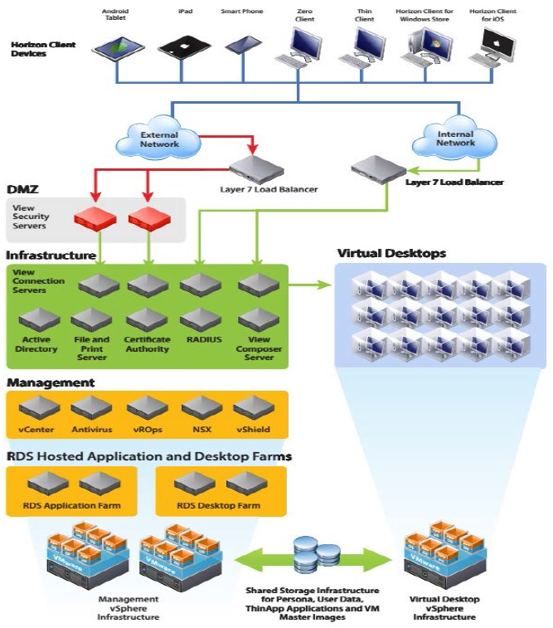
VMware Datacenter Architecture – Private Datacenter
?
MVP Phase
Phase II & III
and
Support
Phase
Notes:
VMware ESXi (formerly ESX) is an enterprise-class, type-1 hypervisor developed by VMware for deploying and serving virtual computers

Slide 9
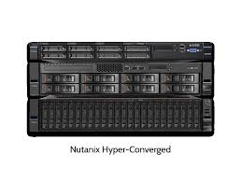
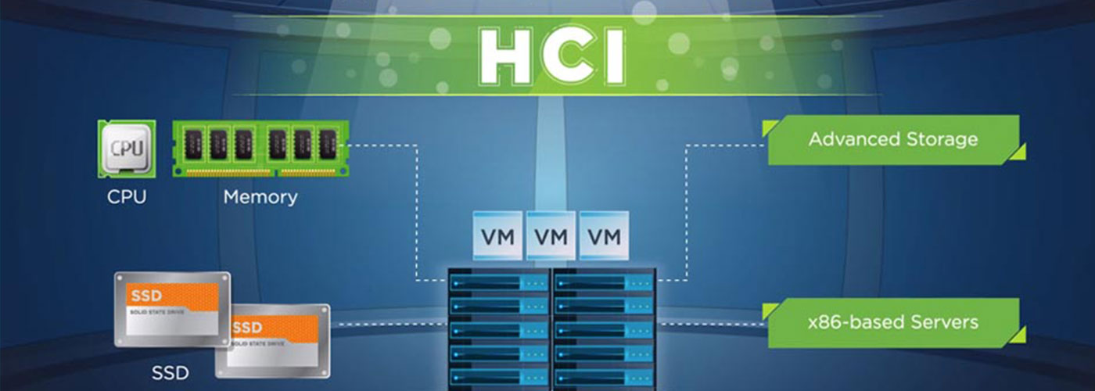
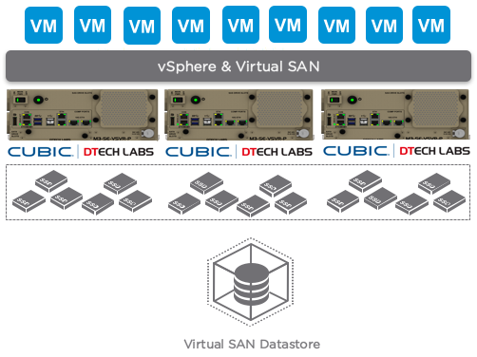
Hyper-Converged
?
MVP Phase
Phase II & III
and
Support
Phase
Notes:
VMware ESXi (formerly ESX) is an enterprise-class, type-1 hypervisor developed by VMware for deploying and serving virtual computers

Slide 10
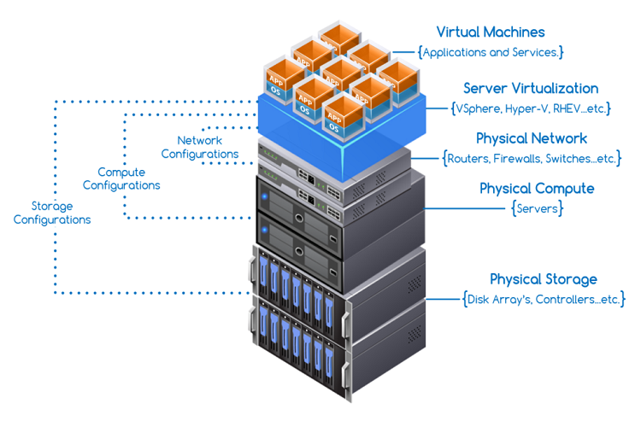
Hyper-Converged
?
MVP Phase
Phase II & III
and
Support
Phase
Notes:
VMware ESXi (formerly ESX) is an enterprise-class, type-1 hypervisor developed by VMware for deploying and serving virtual computers

Slide 11


Benefits of Virtualization
01
Efficient Use of Resources
02
Cost Effective
Benefits
03
Agility
04
Resilient
05
Security
06
Less Maintenance Overhead

Slide 12
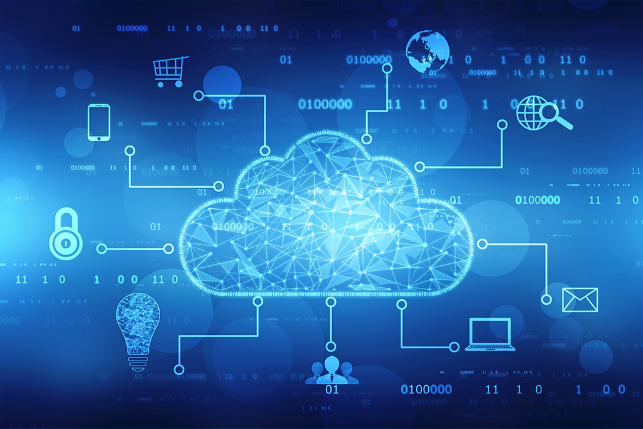
Cloud

Slide 13
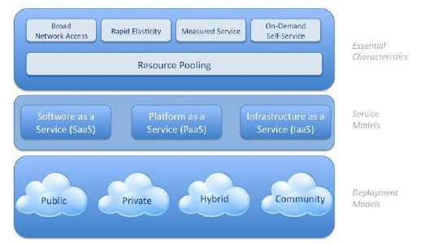
Cloud Computing
Cloud computing is a model for enabling ubiquitous, convenient, on-demand network access to a shared pool of configurable computing resources (e.g., networks, servers, storage, applications, and services) that can be rapidly provisioned and released with minimal management effort or service provider interaction.
MVP Phase
Phase II & III
and
Support
Phase

Slide 14
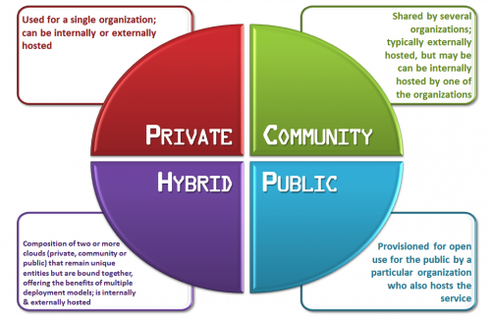




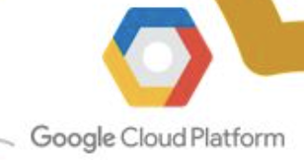

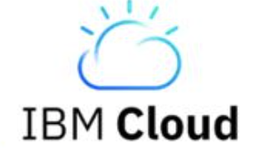
Cloud Deployment Models
Selecting a Deployment Model business constraints and requirements such as Business Policies, functions and security and compliance.
Phase II & III
and
Support
Phase
Notes:
Functions – IOT processing at Edge locations
Security from a compliance perspective
Community Cloud – Healthcare, Science, Education

Slide 15
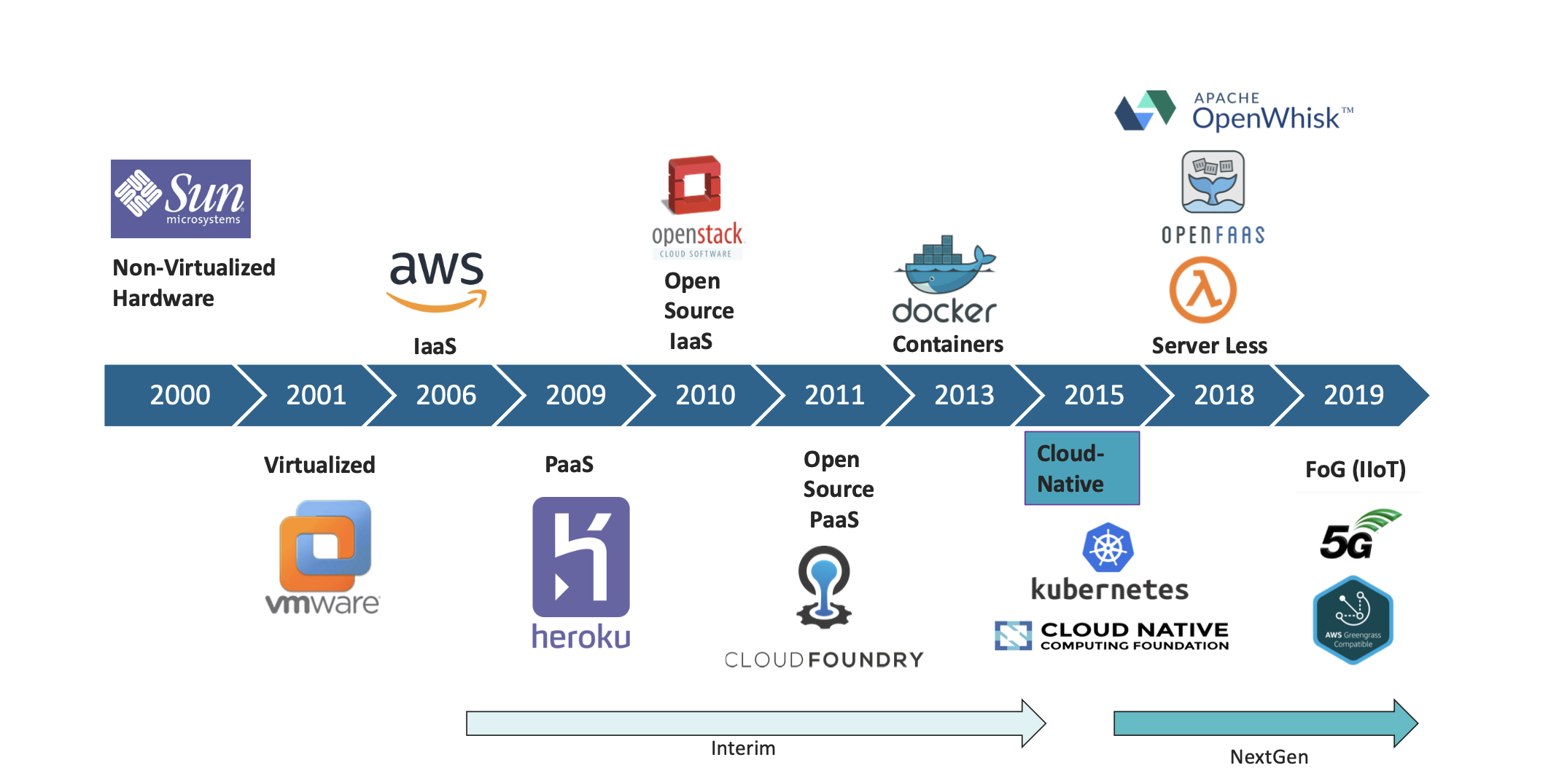
Evolution of Cloud
MVP Phase
Phase II & III
and
Support
Phase
Notes:
Serverless computing is a cloud computing execution model in which the cloud provider allocates machine resources on demand, taking care of the servers on behalf of their customers
function-as-a-service offerings - serverless functions are event-driven, meaning the code is invoked only when triggered by a request. The provider charges only for compute time used by that execution
Fog computing or fog networking, also known as fogging, is an architecture that uses edge devices to carry out a substantial amount of computation, storage, and communication locally and routed over the Internet backbone
with Fog computing, the data is processed within a fog node or IoT gateway which is situated within the LAN. As for edge computing
Fog computing uses a centralized system that interacts with industrial gateways and embedded computer systems on a local area network, whereas edge computing performs much of the processing on embedded computing platforms directly interfacing to sensors and controllers.

Slide 16
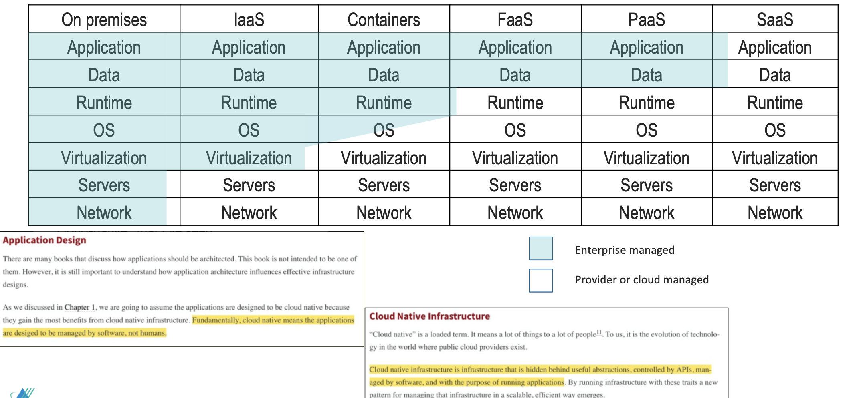
Cloud Service Models
Phase II & III
and
Support
Phase
Notes:
Functions – IOT processing at Edge locations
Security from a compliance perspective
Community Cloud – Healthcare, Science, Education

Slide 17
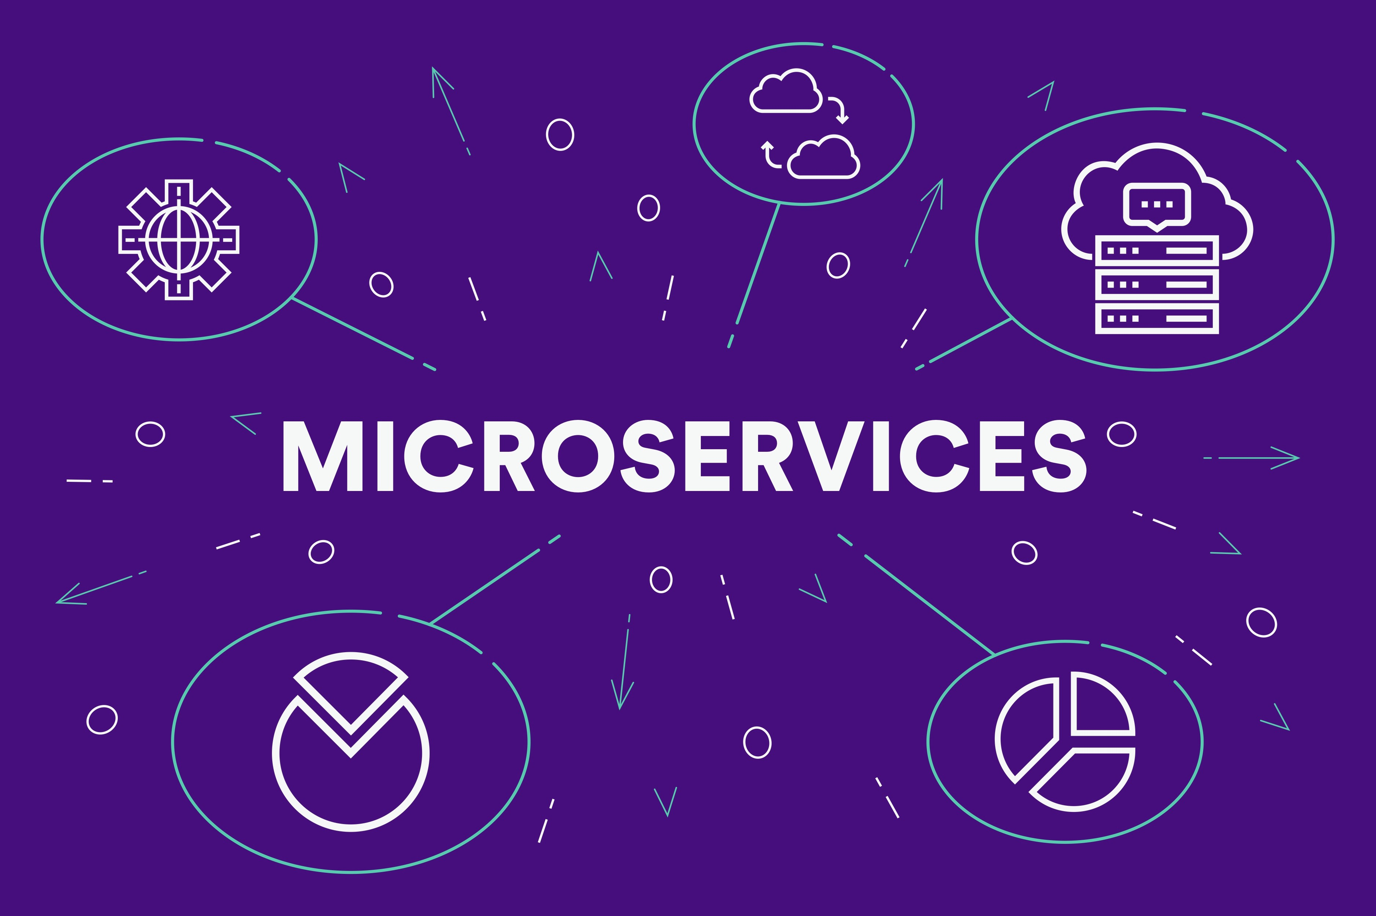

Slide 18
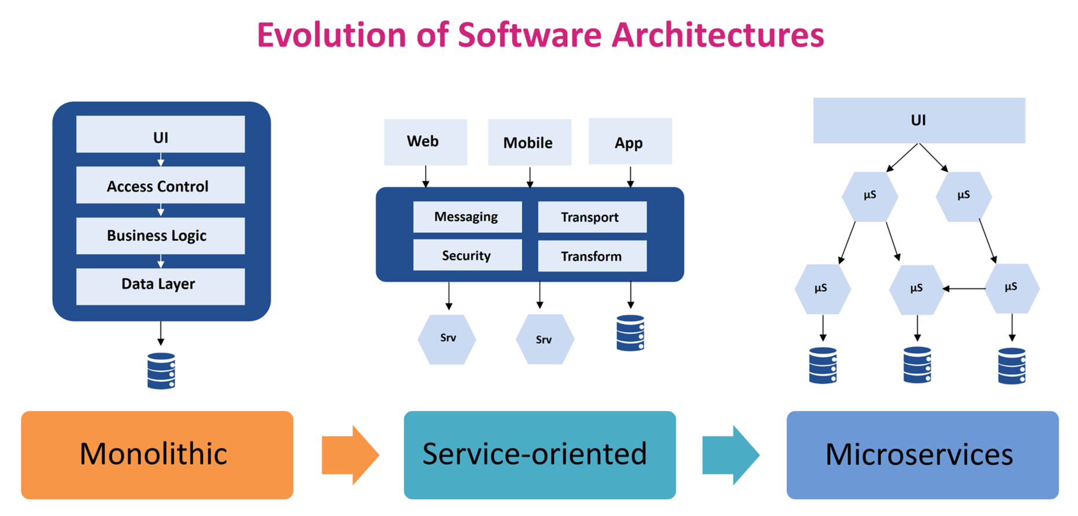
Evolution of Software Architecture
MVP Phase
Easy to design
Performance
Strong coupling
Implemented in silos
Same Tech stack
Inflexible deployment
Inefficient resource usage
Sharing Data /Functionality
Polyglot of services
Loose coupling
Complicated & Expensive
Lack of Tooling
Long Development cycle
Independently deployable
Easy to maintain & test
Small Teams
Domain Driven Design
Design Traps
Coordination across multiple projects
Phase II & III
and
Support
Phase

Slide 19
Microservices
Principles of Microservices
Componentization
Organize around business capabilities
Products, not Projects
Smart End Points and Dump Pipes
Decentralized Governance
Infrastructure Automation
Design for Failure
MVP Phase

Slide 20
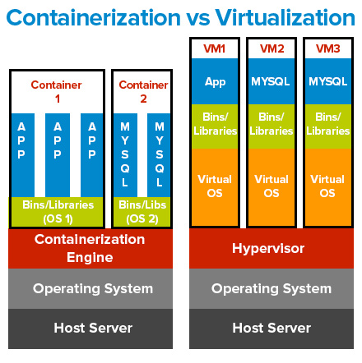
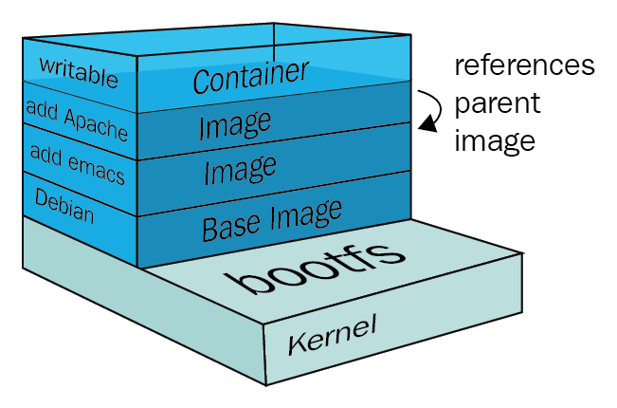
Containerization
Virtualization enables you to run multiple operating systems on the hardware of a single physical server
Containerization enables you to deploy multiple applications using the same operating system on a single virtual machine or server.
?
MVP Phase
Phase II & III
and
Support
Phase
Notes:
Virtualization enables you to run multiple operating systems on the hardware of a single physical server, while containerization enables you to deploy multiple applications using the same operating system on a single virtual machine or server.

Slide 21
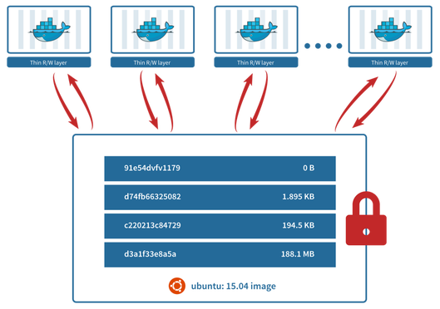
Container Images
?
Unlike VM image which is a single large file, a Docker image references a list of read-only layers that represent differences in the filesystem
This makes building, pulling, pushing, and copying of images fast and saves on storage and enables faster image transfers.
When a container is deleted, all data stored is lost
Docker allows mounting host’s filesystem directly into the container. This ensures that the data is persisted even after the container is deleted
MVP Phase
Phase II & III
and
Support
Phase
Notes:
Virtualization enables you to run multiple operating systems on the hardware of a single physical server, while containerization enables you to deploy multiple applications using the same operating system on a single virtual machine or server.

Slide 22
Docker
Docker Container is standardized, encapsulated environment that runs application
Lightweight
Runs anywhere
Build instances from read-only template (Docker image).
Build using Dockerfile (Image Layers and Configurations)
Images are used to store and ship applications using Container Registry (DockerHub)

Slide 23
Docker
Demo
Run Docker container from registry
DockerFile
Multiple Containers
Networking

Slide 24
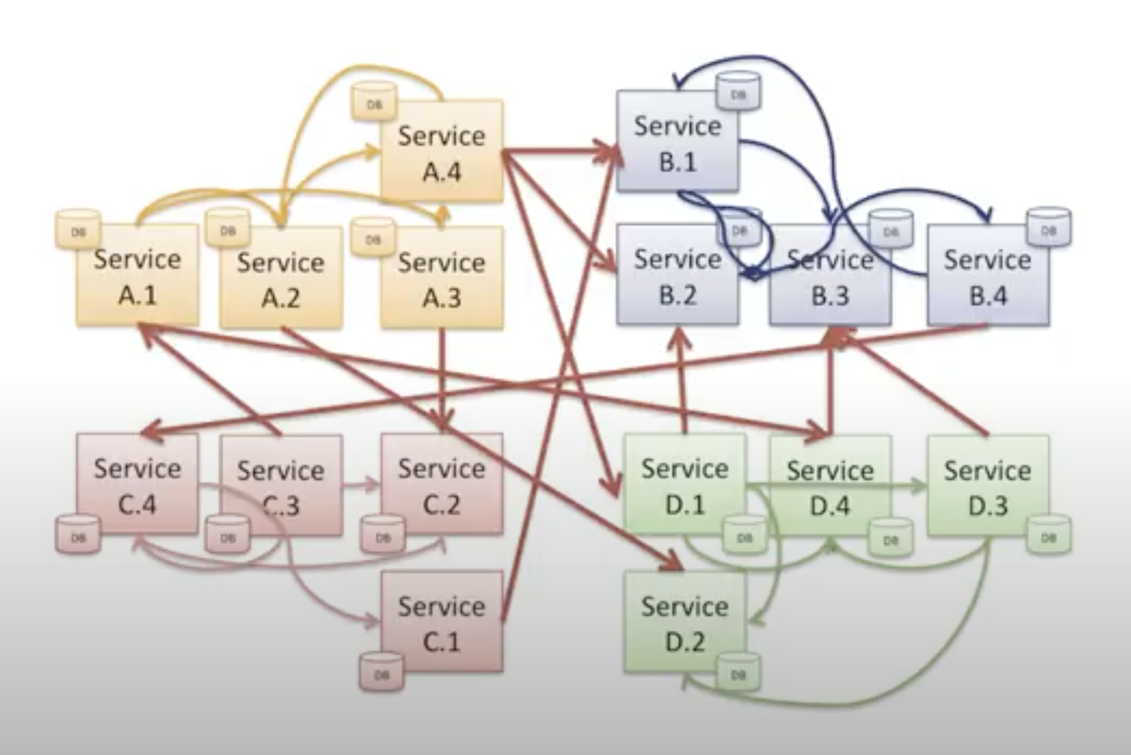
Managing Docker Containers

Slide 25
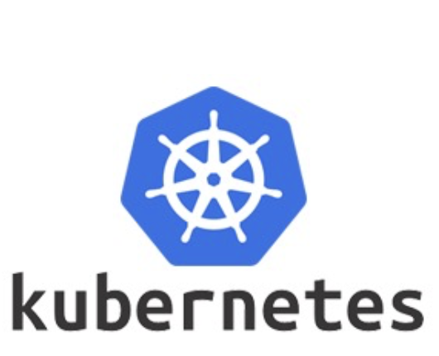
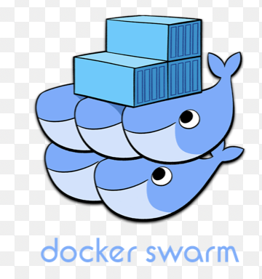

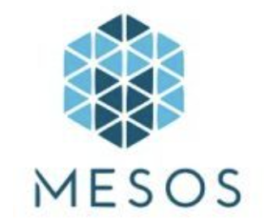
Container Orchestration
Container orchestration is managing the lifecycles of containers, especially in large, dynamic environments. Software teams use container orchestration to control and automate many tasks:
Provisioning and deployment of containers
Redundancy and availability of containers
Scaling up or down to spread application load evenly across host infrastructure
Movement of containers from one host to another if there is a shortage of resources in a host, or if a host dies
Allocation of resources between containers
External exposure of services running in a container with the outside world
Load balancing of service discovery between containers
Health monitoring of containers and hosts
Configuration of an application in relation to the containers running it
?
MVP Phase
Phase II & III
and
Support
Phase
Notes:
Virtualization enables you to run multiple operating systems on the hardware of a single physical server, while containerization enables you to deploy multiple applications using the same operating system on a single virtual machine or server.

Slide 26
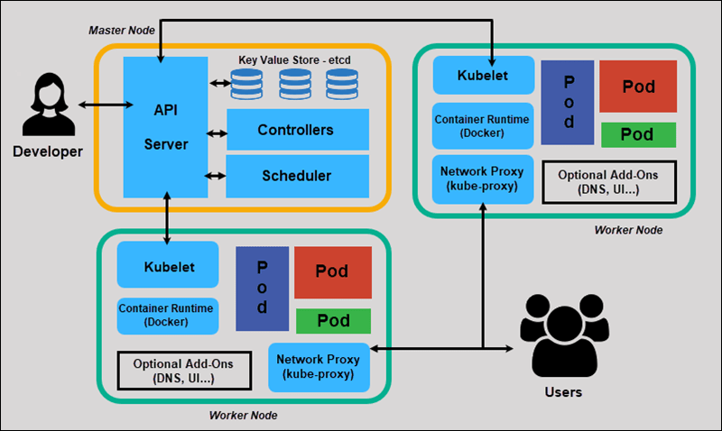
Kubernetes – Manage container workload

Slide 27
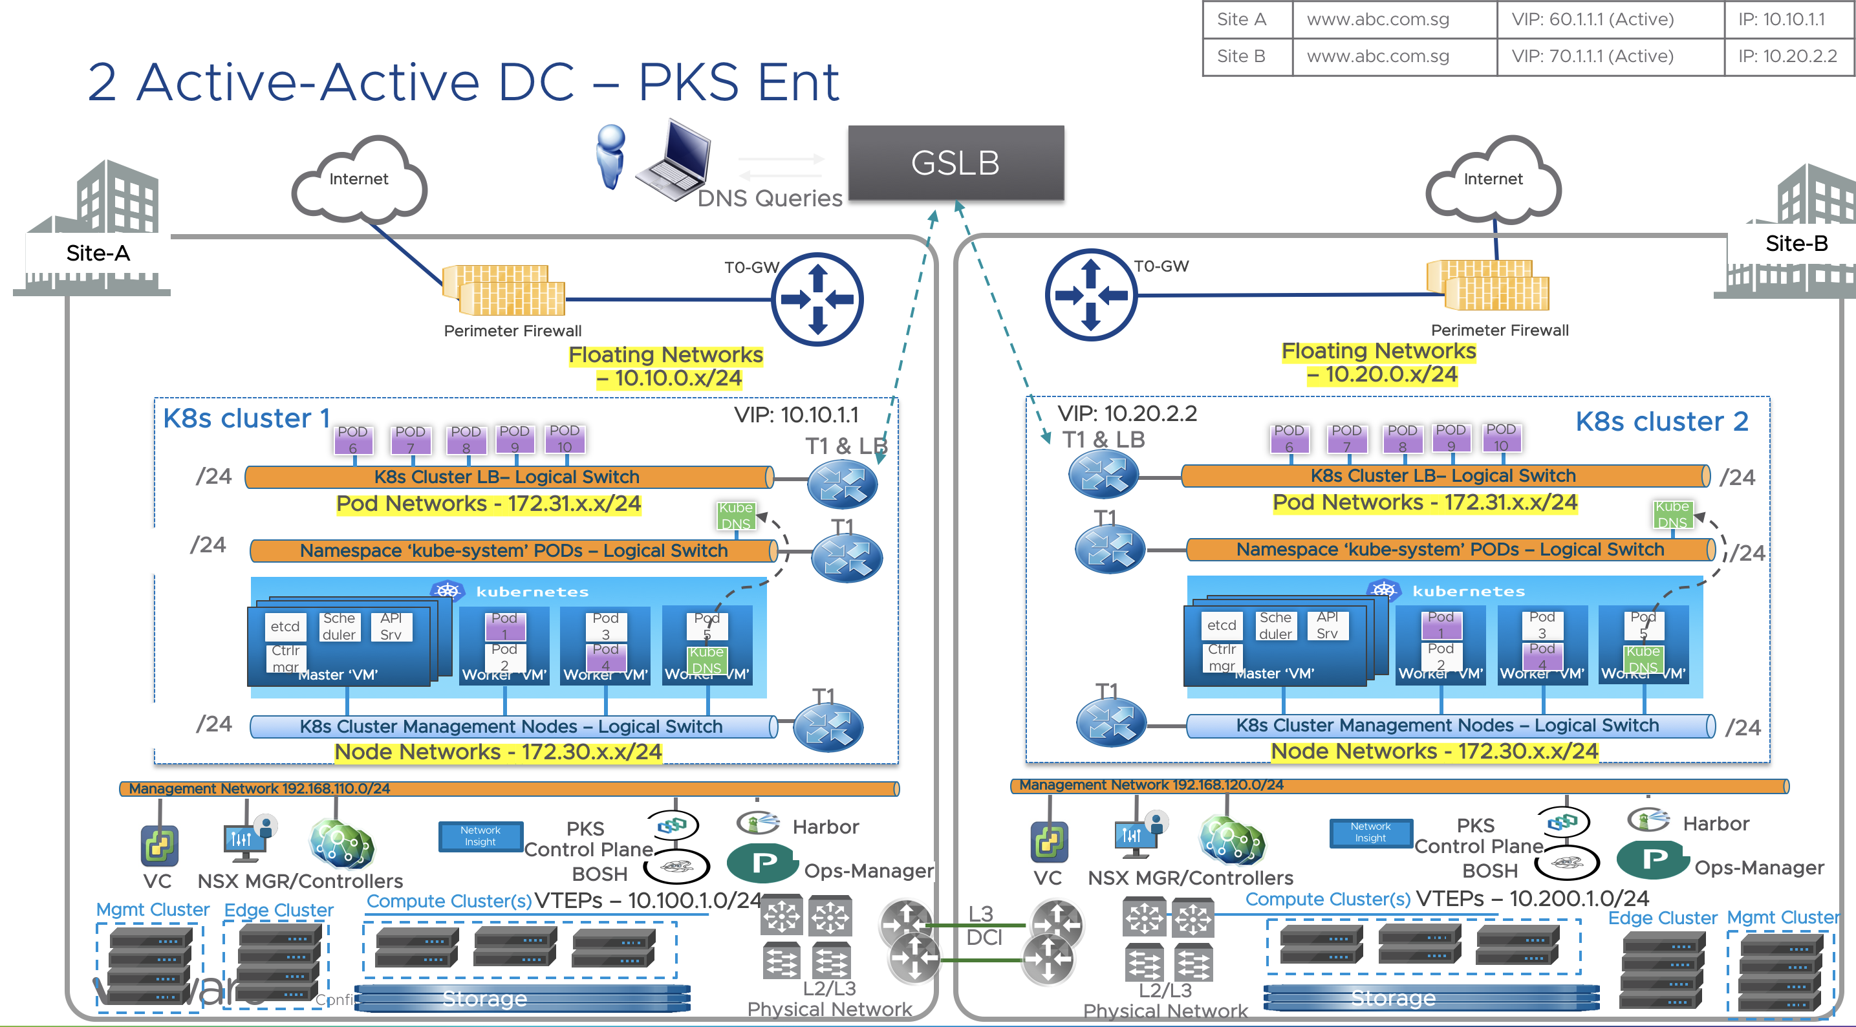
Kubernetes – Datacenter

Slide 28
Kubernetes
Demo
Run PODs / containers
Kubernetes Services
Deployments
Rollback

Slide 29
Kubernetes
Additional
Monitoring tools
Istio Service mesh
Security - Authentication

Slide 30
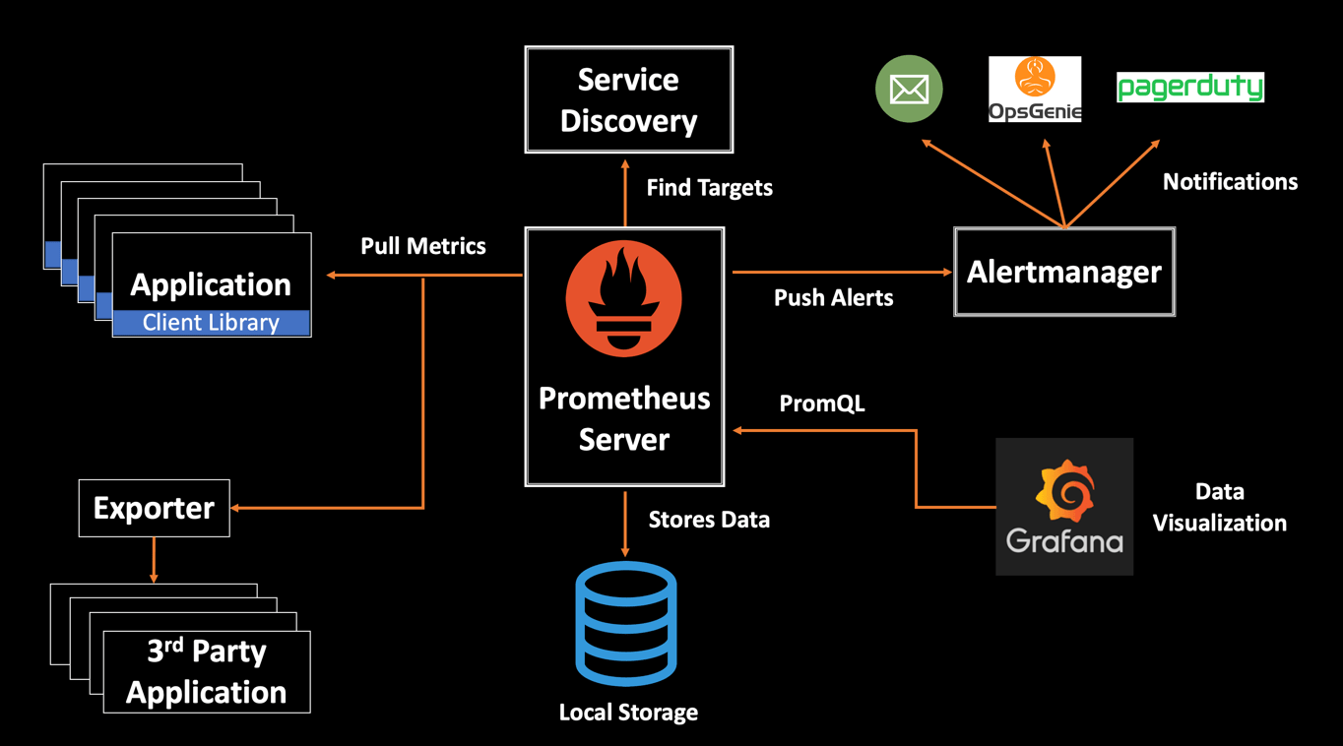
Kubernetes Monitoring - Prometheus

Slide 31
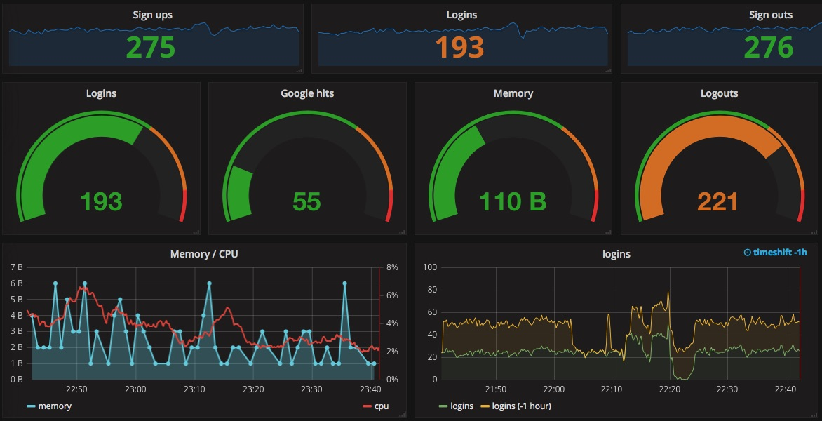
Kubernetes Monitoring - Grafana

Slide 32
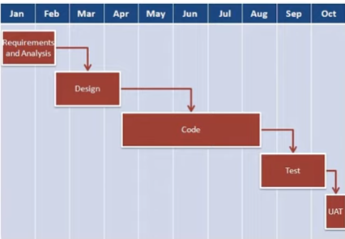
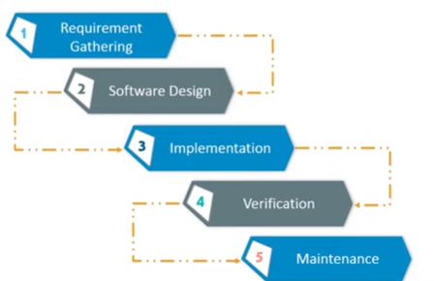
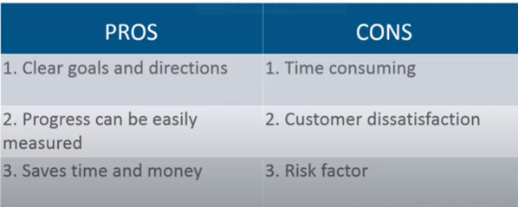
waterfall

Slide 33
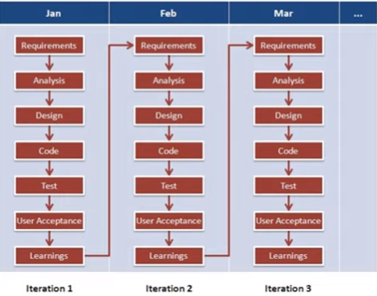
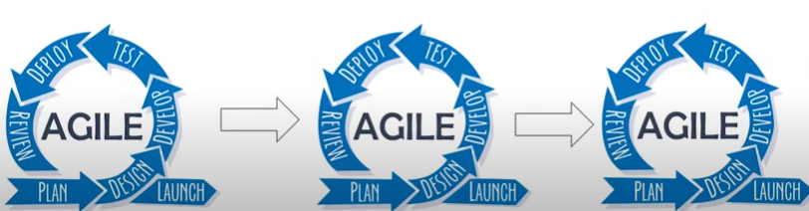
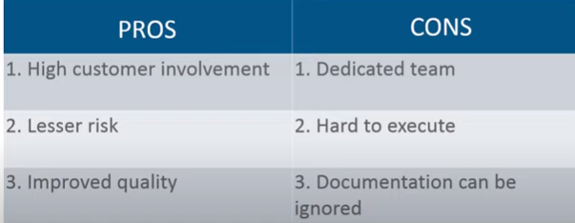
Agile

Slide 34

THANK
YOU
INFINITE COMPUTER SOLUTIONS

